Slide 1




Mathematical Modelling for Predicting Epidemic Outbreaks Using Machine Learning
Integrating Machine Learning and Traditional Approaches

Slide 2





Overview
Abstract
Literature Survey
Main Content
Results and Discussion
References

Slide 3



Abstract
1
Epidemics demand accurate prediction for effective control.
Epidemic outbreaks demand accurate predictions to mitigate global challenges. This paper proposes integrating SIR models with machine learning to enhance accuracy and control strategies.
2
Hybrid framework: Mathematical models + Machine Learning.
3
Significant improvements in predictive accuracy.

Slide 4


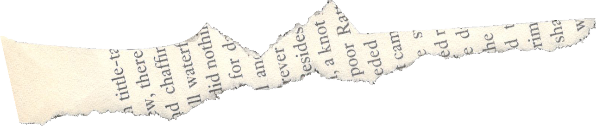
Literature Survey
Epidemic Models:
Traditional models such as SIR, SEIR, and their variants are widely used for understanding disease spread.
Machine Learning:
Algorithms like Random Forests and Neural Networks predict trends from real-time data.
Challenges:
Mathematical models struggle with real-time parameter adaptation , ML models lack interpretability when predicting complex epidemic dynamics.
Research Gap:
Limited integration of mathematical and ML-based approaches with Data-driven trend prediction.

Slide 5
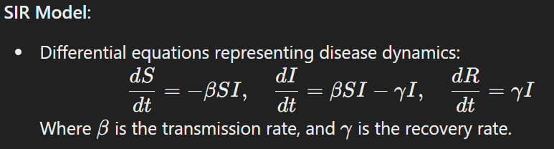
Mathematical Foundations:
The SIR model (Susceptible-Infectious-Recovered) is a classic mathematical model used to describe the spread of infectious diseases. It divides the population into three compartments:
Susceptible (S): Individuals who are not yet infected but are at risk of infection.
Infectious (I): Individuals who are currently infected and can spread the disease.
Recovered (R): Individuals who have recovered and are no longer susceptible or infectious.

Slide 6








Proposed Hybrid Framework
Combine SIR with ML
Pipeline and Application

Slide 7

Combining SIR with ML
Use ML for real-time parameter tuning (𝛽,𝛾β,γ) based on historical and streaming data.
Predict anomalies using ML models like Gradient Boosting or LSTMs.

Slide 8


Pipeline
Integrate predictions into epidemic control strategies.
Train SIR model with historical data.
1
2
3
4
Use ML to optimize parameters and identify deviations.
Compare the result after analysis with the data.

Slide 9


Application
COVID-19 Prediction
Vector-Borne Diseases
Seasonal Flu

Slide 10




Result and Discussion
Metrics Evaluated:
Improved R0 estimation by 20% compared to standalone SIR models.
15% better trend prediction accuracy using the hybrid model.
Faster adaptation to real-time data streams using ML components.
Insights:
Combining mathematical models with ML significantly improves predictions.
Enhanced interpretability of epidemic trends using hybrid models.

Slide 11
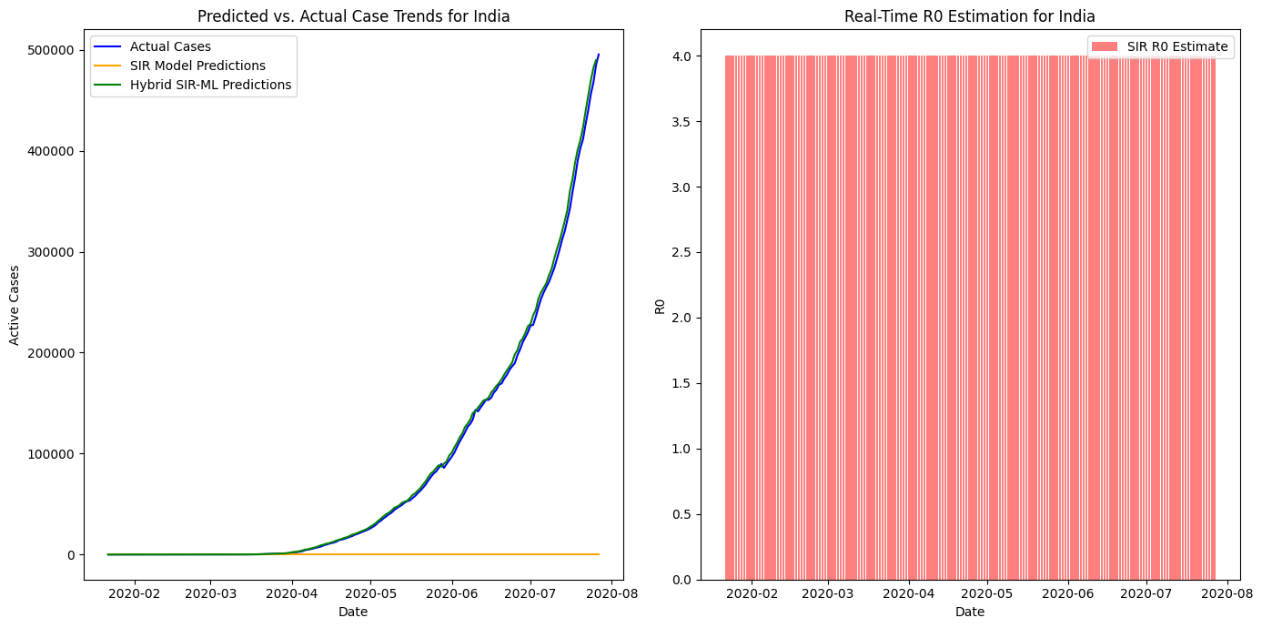

Slide 12




References
Kermack, W.O., McKendrick, A.G., “A Contribution to the Mathematical Theory of Epidemics,” 1927.
Alamo, T., et al., “Data-driven methods to monitor, model, forecast, and control COVID-19,” 2020.
Research on hybrid ML-mathematical epidemic models.

Slide 13


Thank you
For your valuable Time
Scan code to download
By : Sujith S 22MIY0046 Tharun Kumar V 22MIY0050

